Slide 1
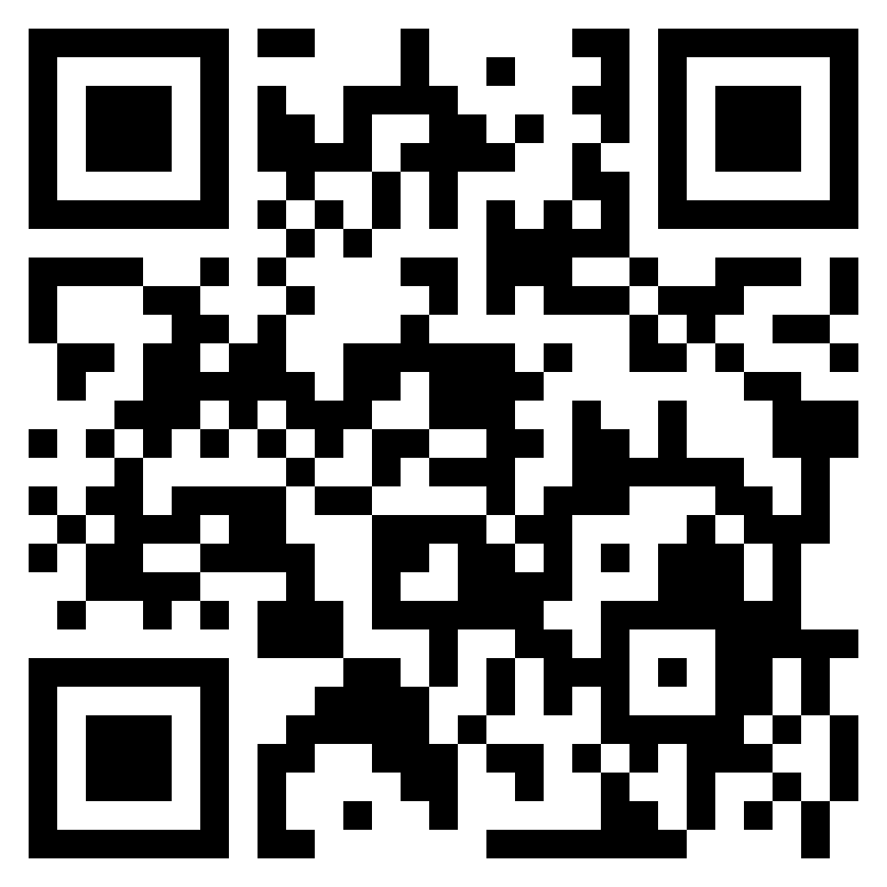
Contextual Security Analysis
(CSA)

Slide 2
Firstly, a big THANK YOU! to:
Troy Marshall
Sean Poris
Ben Pick
Mike McCabe
Rinaldi Rampen
ALL OF YOU! 👏👏👏
🙇

Slide 3

Ken Johnson
@cktricky
Co-Host of Absolute AppSec
CTO of DryRun Security
BJJ Nerd

Slide 4
Common language / terminology
Dynamic Application Security Testing (DAST) | Sending requests to running web applications and then observing & analyzing the application’s behavior.
Static Application Security Testing (SAST) | Analysis of the source code, in its a non-execution environment, for patterns & anti-patterns that indicate a potential security issue.
Contextual Security Analysis (CSA) | A modern, comprehensive risk assessment of software changes using a multitude of factors/data-points.
AI / LLM | Witch magic 🧙‍♀️

Slide 5
Outline
A Brief History: DAST, SAST & Me
Introducing Contextual Security Analysis
Current examples
Overview of CSA
S.L.I.D.E.
Surface
Language/Framework
Intent
Detection
Environment
LLMs / AI
Use cases
Examples
🛣️

Slide 6
A Brief History:
SAST/DAST
&
Me

Slide 7
A Brief History: SAST, DAST, & Me
1995 - 2004
2005-2010
2011-2017
2017-2023
Me: School & Navy
Me: LivingSocial / xVisium
Me: GitHub / DryRun Security
Me: Pentagon / FishNet Security
95 - JavaScript released
98 - SQL Injection 98 - AppScan by Sanctum
00? - Web Inspect by Spi Dynamics
02 Ounce labs
03 Fortify
06 Veracode
06 CheckMarx
12 - Dependency Check
12 - A9 OWASP Category introduces
13 - Brakeman
15 - Retire.js 15 Synk launches
19 Semgrep
19 CodeQL 22 Co-Pilot
IMPORTANT!!!

Slide 8
Takeaways
🖥️ DAST sort of dropped off along the way…
🧑‍💻Tools marketed with developers in mind
⚙️Tools still built with Security expertise required (problematic for Security Champions)
🙅‍♂️Perfection in DAST/SAST does not exist. Our tolerance for mistakes is way higher than we’d like to admit

Slide 9
Known Gaps
Technology stacks are adopted faster than we can write tools
Scanners of today are a singular, mixed-result accuracy data point
Completely ignores the following data points:
Previously discovered vulnerabilities
Known dangerous portions of a codebase
Code Quality risk markers
Authorship completely ignored as a risk factor
Existing Service Risk
… The list goes on (S.L.I.D.E.)

Slide 10
Conclusion
🧐
Write something:
✅ Practical for people defending
✅ Harnesses existing tooling & pipeline
✅ Build on top of existing tribal knowledge
✅ Balance between adaptability/speed and perfection

Slide 11
Contextual Security Analysis (CSA)

Slide 12
Tell me you’re doing CSA without telling me you’re…

Slide 13
Practical Use Cases
Awareness:
Looking for new risks in code changes using more than one factor
Variant Analysis & Regressions:
Looking for similar issues that have cropped up in the past
Remediation:
Assist developers

Slide 14
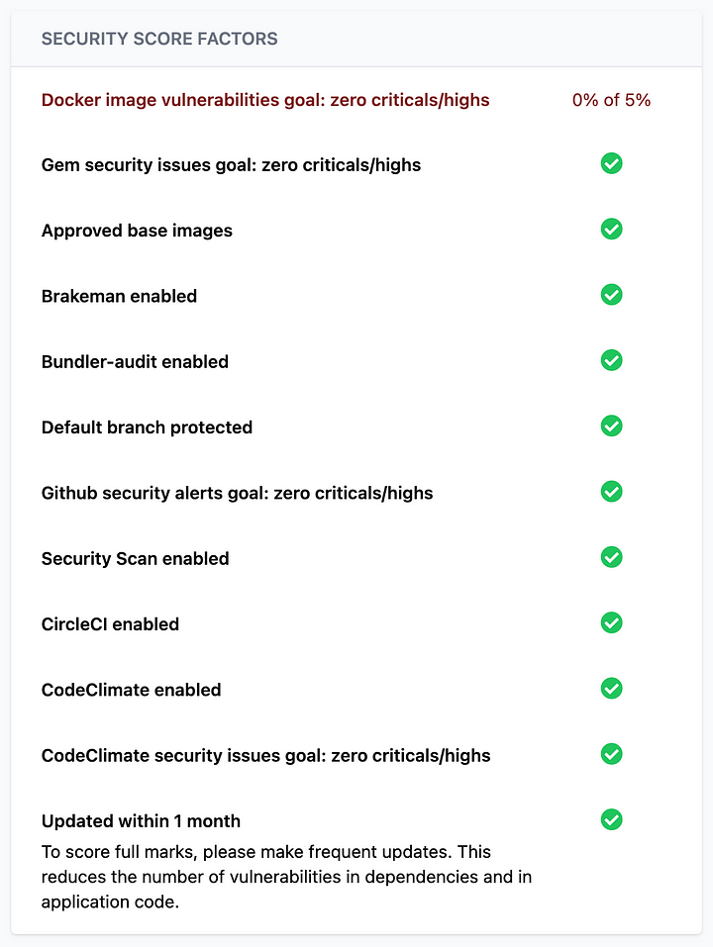
Chime & Monocle
📚https://medium.com/life-at-chime/monocle-how-chime-creates-a-proactive-security-engineering-culture-part-1-dedd3846127f
✅ USES MULTIPLE RISK FACTORS 💥
✅ Practical for people defending
✅ Harnesses existing tooling & pipeline
✅ Balance between adaptability/speed and perfection

Slide 15
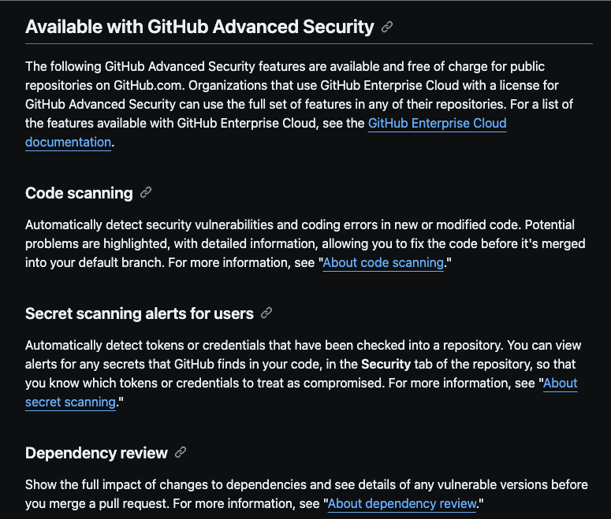
GitHub Advanced Security (GHAS)
https://docs.github.com/en/code-security/getting-started/github-security-features#available-with-github-advanced-security
REVEALS MULTIPLE RISK FACTORS:
Dependency scanning
CodeQL results
Secret Scanning

Slide 16
Practical Use Cases
Awareness:
Looking for new risks in code changes using more than one factor
Variant Analysis & Regressions:
Looking for similar issues that have cropped up in the past
Remediation:
Assist developers

Slide 17
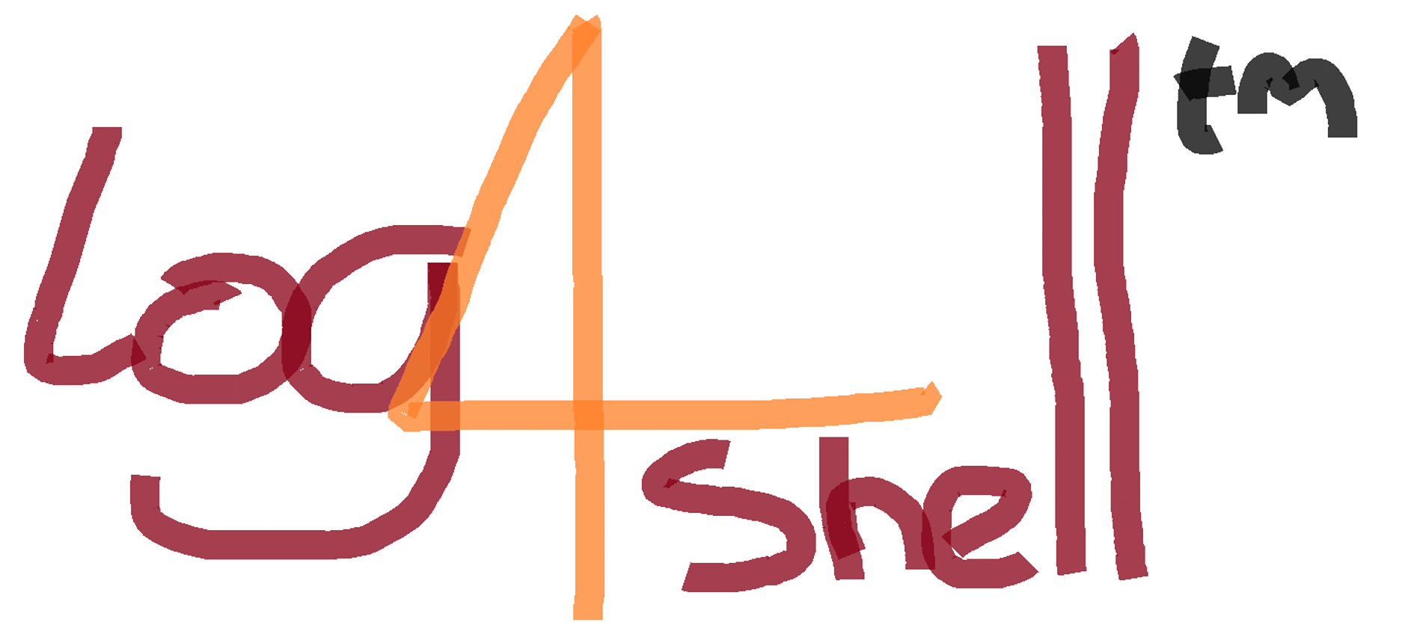
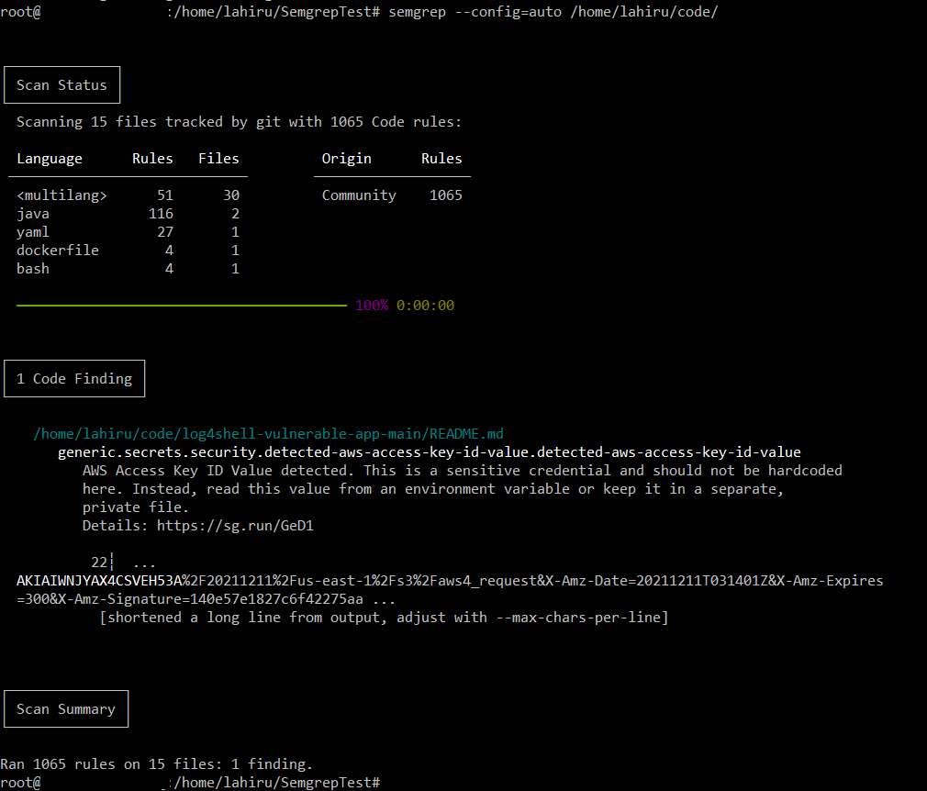
Semgrep
📚https://www.jit.io/blog/semgrep-to-uncover-log4j-vulnerabilities
✅ Practical for people defending
✅ Priotizes speed (important when an incident occurs)
✅ Harnesses existing tooling & pipeline

Slide 18
Practical Use Cases
Awareness:
Looking for new risks in code changes using more than one factor
Variant Analysis & Regressions:
Looking for similar issues that have cropped up in the past
Remediation:
Assist developers

Slide 19
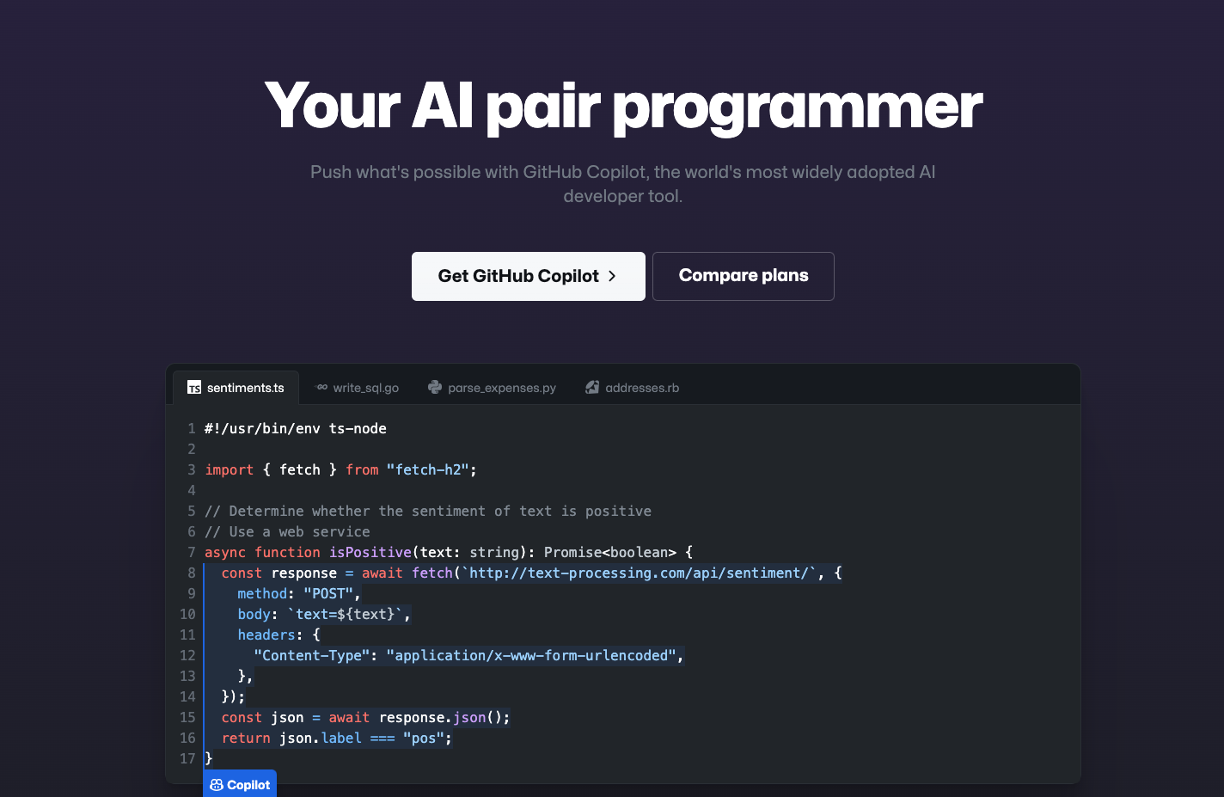
Co-Pilot
📚https://github.com/features/copilot ✅ Practical for people defending
✅ Prioritizes speed over perfection
✅ Harnesses existing tooling & pipeline

Slide 20
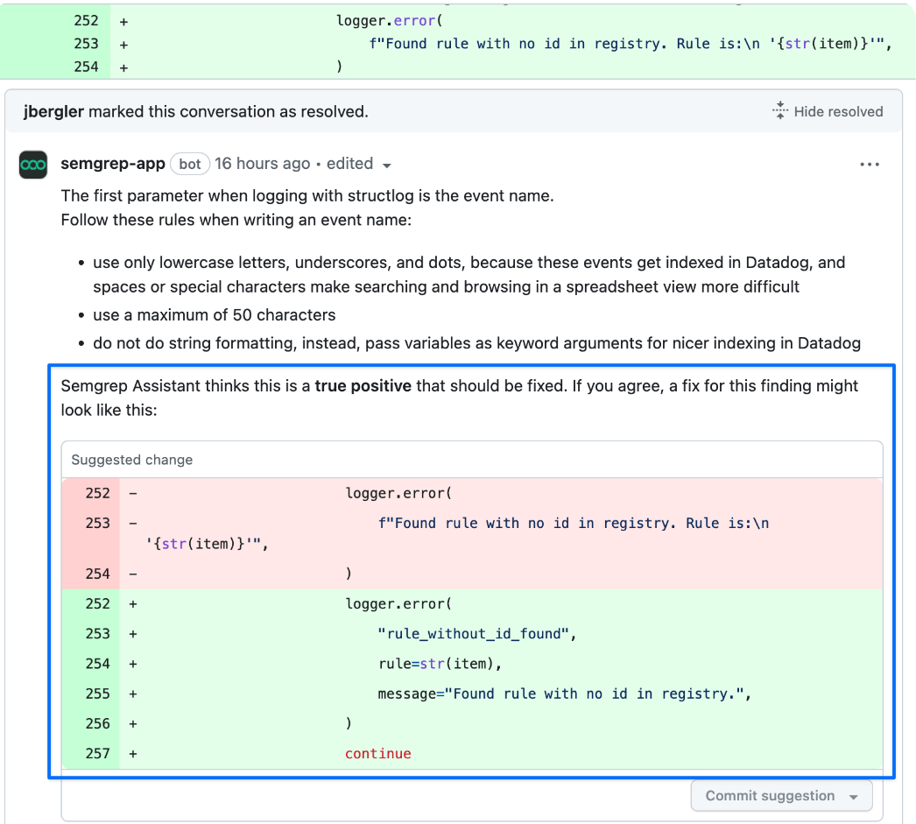
Semgrep Assistant
📚https://semgrep.dev/products/semgrep-code/assistant/

Slide 21
Key concepts 💡
Ideally, we merge these strategies together
There are still signals for risk that we’re not yet tapping into
We need tooling to keep pace with internal technology adoption
Scaling knowledge is key

Slide 22
Overview

Slide 23
Context > Control

Slide 24
Control Context
(S,D,I)AST embodies this:
😭Limited data points
😭Enforcement of rules
😭Blocking checkpoints 😭Pattern matching
Next Gen:
😍Combines many data points
😍Warnings & guidance over enforcement
😍 Remediation assistance
😍 Risk-focused
Download Link: https://www.dryrun.security/resources/csa-guide

Slide 25
CSA - SLIDE 🛝
Surface | How the surface of the application changes
Language | Language and framework that the application is written in
Intent | Evaluates the person making the change, both in their patterns and their purpose
Detection | Tooling in place to detect vulnerabilities and security issues
Environment | Purpose of the application and service in the organization

Slide 26
SLIDE - Surface
⚠️Sensitive Code Paths
🚧 HTTP Routes
Depending on your language and framework, this could be configuration files, middleware, controllers, or how your application and service handles auth.
Routes refers to an exposed endpoint on an application that will take user-supplied information and perform an action. Expansion or contractions of these routes in an application inherently change the risk profile of the application.

Slide 27
SLIDE - Language
💬Source Language
🧱Web Framework
This weighs the language used (ex: Golang, Rust, PHP, etc.) as each has their own security issues and known vulnerabilities.
Each web framework contains their own unique variations of sensitive areas, configurations, and components. Framework nuances are subtle and highly specific security issues that are akin to “footguns” 🦶🔫.

Slide 28
SLIDE - Intent
📡 Authorship frequency
🫅Author is not an owner
If the author rarely commits or has never committed to this repo this indicates the author may be unfamiliar with the development standards of the code base.
Code changes to a portion of code in which the author is not an owner or on a team that owns this portion of the code.

Slide 29
SLIDE - Detection
🤐 Secrets
👩‍🔬 Testing
Secret scanning technology has enabled the detection of sensitive keys when pushed in source code. This is a major indicator of risk in a code change.
Consuming (S|D)AST, dependency, docker image, etc. scanner tool output. Past bug bounty submissions as a historical reference to known dangerous anti-patterns. Similar concept with vulnerabilities Identified by internal/external security contributors.

Slide 30
SLIDE - Environment
💪 Change protection
👩‍💼 Business Risk
Does the application utilize branch protection features or other testing-relevant gating mechanisms to ensure evaluation of new code changes?
Critical factors include the level of risk a service poses through its business function, the type of data it processes/stores/transmits, and its overall importance to the business.

Slide 31
!(Deterministic vs Probabilistic)

Slide 32
Surprise… it’s both! 🎉
Probabilistic | Use to gather context (ie - is this touching authentication?) Use to provide (anti)pattern analysis 🧠 (ie - does this match the pattern for a previously known 🐛)
Deterministic | Also can be used to gather context (ie - Write code that checks if this is a first time repo author) Specific things that produce exact matches (ie - Write code / Semgrep pattern)
🏆USE THE OUTPUT OF BOTH TO REVEAL RISK 🏆

Slide 33
AI & You

Slide 34
Personal recommendations
🔬🧪Start experimentation with Baseplate or something similar
📖 Read this article:
https://engineering.peerislands.io/extending-openai-gpt-4-using-langchain-and-pinecone-for-q-a-over-your-own-content-using-1f3e9dc10e91
📖 Read this book:
https://www.amazon.com/What-ChatGPT-Doing-Does-Work/dp/1579550819

Slide 35

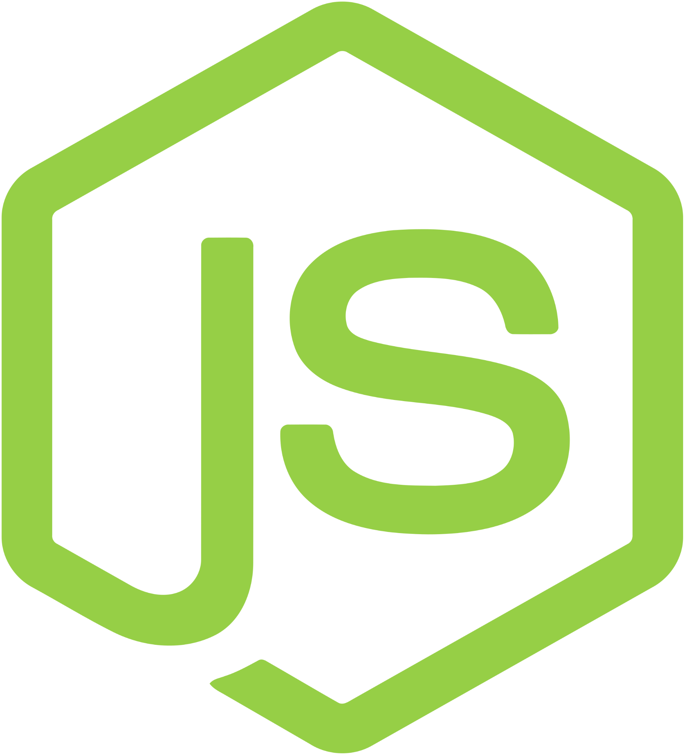
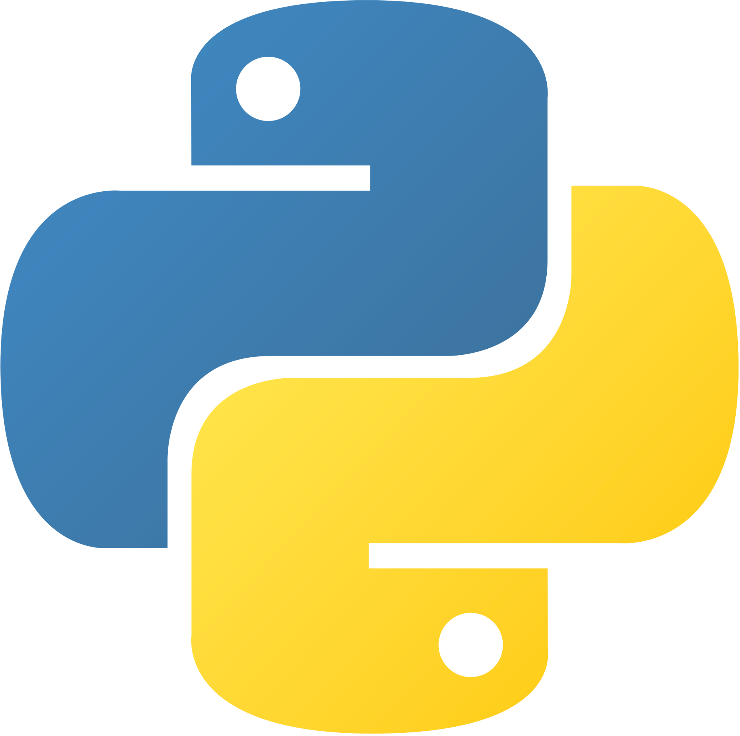
Langchain
Modular Components
LLMs
Compressors
Retrievers
Prompts
Chains
… and way more
+

Slide 36
My AI learnings…
Contextual Compression + Documents, Chains, LLMs, Prompts… they are all highly configurable and can be very accurate
Created the following:
AI Chat bot assistant that can dig through your organization’s secure code docs to answer questions
Analysis agent that provides composition of the application (framework, language, security centric libraries, datastore, etc.)
Analysis agent that looks for known (in your app’s specific code base) security bug patterns

Slide 37
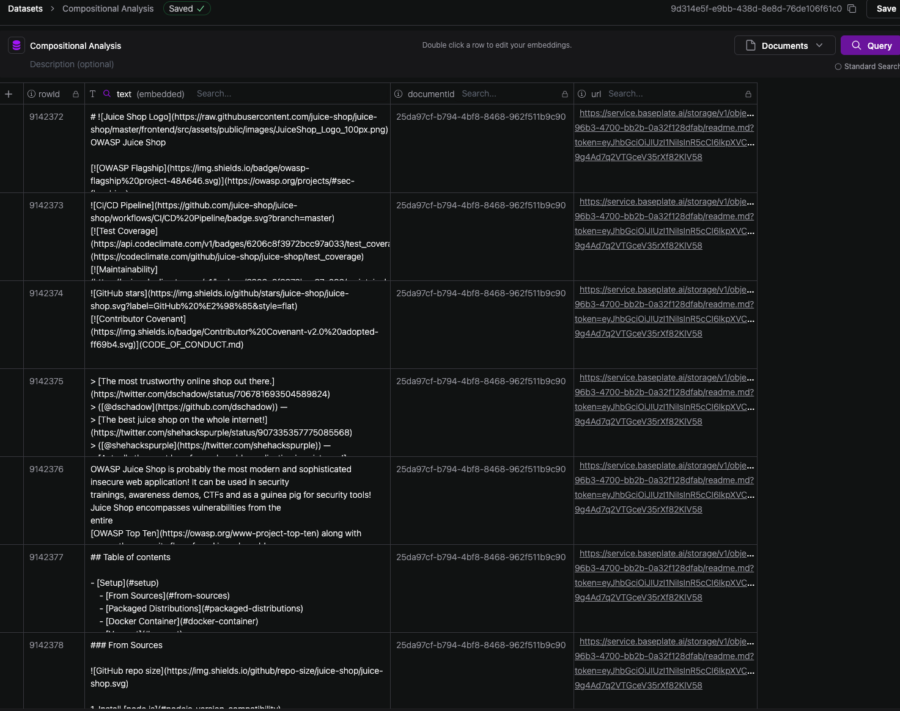
Baseplate - Create Dataset
Dataset:
Juice Shop’s README.md and package.json files

Slide 38
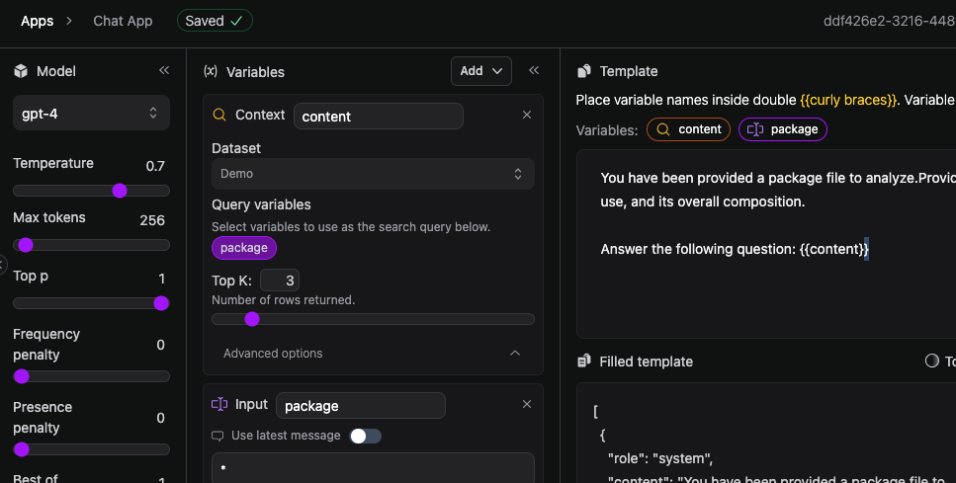
Baseplate - Create App
Provide the following information:
Template
Context (point to a dataset)
Input Variables (Optional)
Start asking questions…

Slide 39
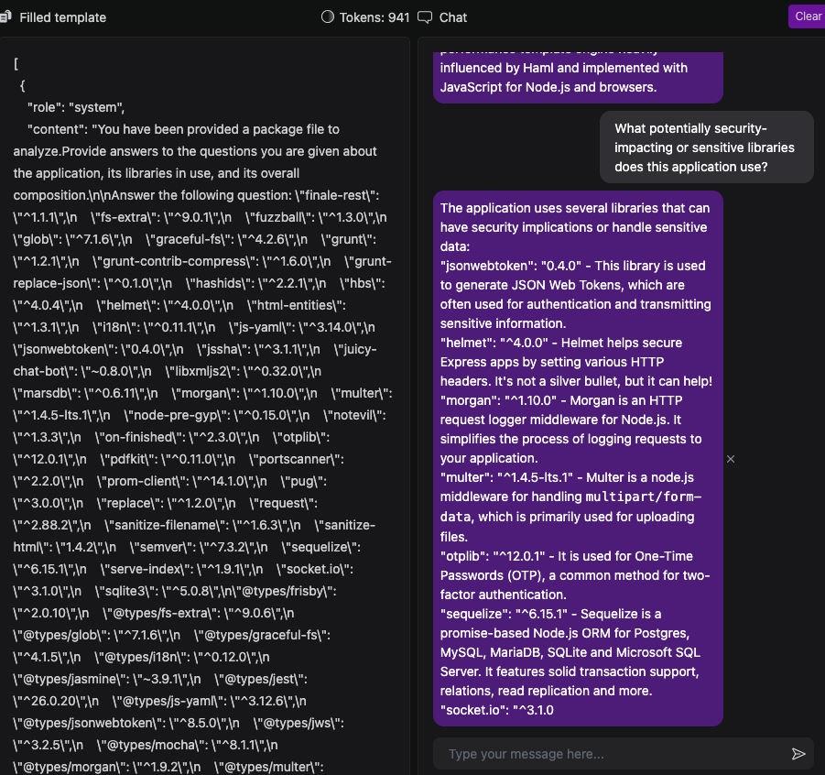
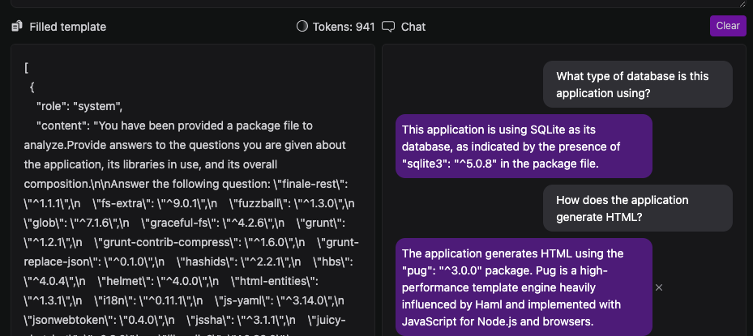
Baseplate - Ask questions

Slide 40

Baseplate Wrap-up
Good for:
Testing
Proof of concept
Creating a chat agent quickly
Learning!
Less good for:
Intense customization
More than chat, though not impossible by any stretch

Slide 41
Customization using Langchain

Slide 42
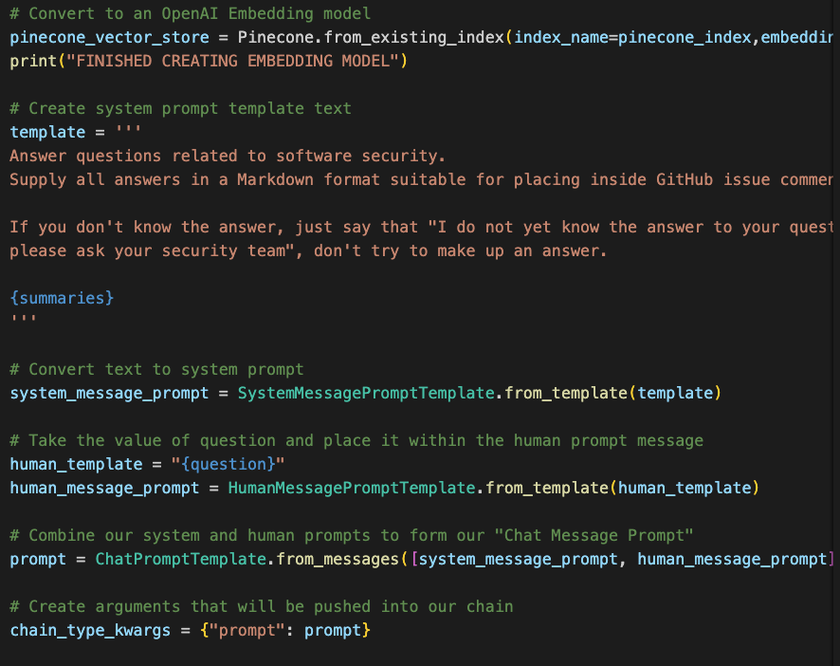
Langchain “Chain” ⛓️
Pinecone vector store
OpenAI embeddings
Prompts (System, Human, Chat)

Slide 43
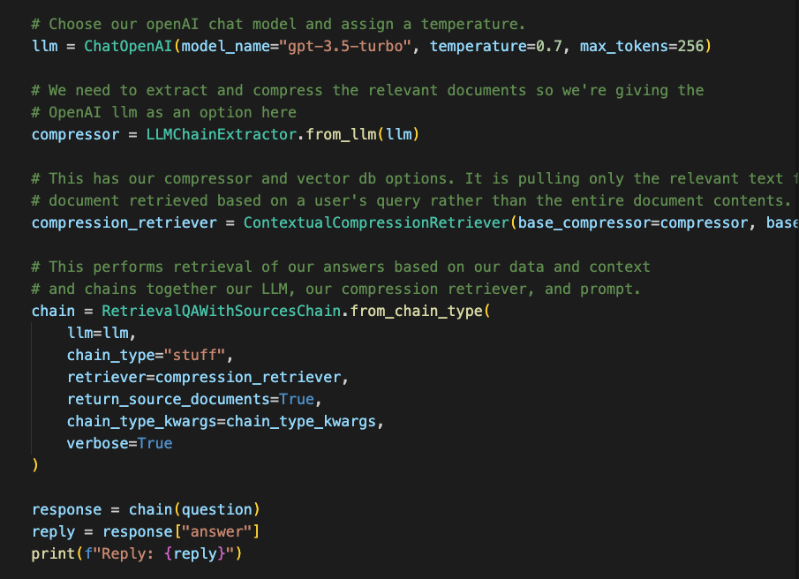
Langchain “Chain” ⛓️
OpenAI LLM
Contextual Compression
Retriever

Slide 45
Final thoughts on building your own AI powered tooling
🔮Know what you’re trying to use it for
🧰Integrate into existing tooling and processes
📊 Harness documentation, tribal knowledge, open source security info, etc.
🥊Combine results from many sources to represent an accurate picture of risk

Slide 46
Conclusion

Slide 47
Things are changing… they must
💡 Too many technology choices to continue testing in isolation using a single data point to determine risk
💡 The power is in your hands to build your own highly customized tooling
💡 Meet developers where they live
💡 AI / LLM can be a for multiplier; is NOT a silver bullet

Slide 48

Contact Info
@cktricky
ken@dryrun.security
youtube.com/@AbsoluteAppSec

